Slide 1
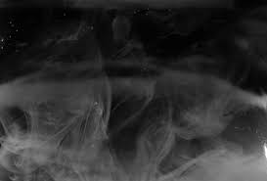
Therotical Analysis of ESP (Electrostatic Precipitator) for removal of fine particles from stack emission and comparision of results with cyclone For particle size ranging from 1 (µm) to 100 (µm)
)
By: Sangeet Pandit (1614032)
Aayush Vora (1714063)
Under the guidance
Dr. Siddappa S Bushnoor
Professor
Department of
Mechanical Engineering

Slide 2

Outline of the Presentation
Outline of the Presentation
1) Background and Motivation
2) Literatuture Review
3) Objectives
4) Materials and Methods
Theoretical Analysis
Experimental Analysis
5) Results and Discussion
6) Summary and Conclusion
7) References

Slide 3

Background and Motivation
Background
Motivation
Cyclone separators or simply cyclones are separation devices (dry scrubbers) that use the principle of inertia to remove particulate matter from flue gases. Cyclone separators is one of many air pollution control devices known as precleaners since they generally remove larger pieces of particulate matter.
In 1907 Frederick Gardner Cottrell, a professor of chemistry at the University of California, Berkeley, applied for a patent on a device for charging particles and then collecting them through electrostatic attraction—the first electrostatic precipitator.
The purpose of this topic is to control air pollution from industries like thermal power plant,steel plants,etc. using Electrostatic Precipitator and Cyclone Seperator and to determine which is better in performance.
The topic also help us to explore in the field of Air Pollution Control Management and Tools related to Manage the pollution.

Slide 4

Literature Review
Louis Theodore,” AIR POLLUTION CONTROL EQUIPMENT CALCULATIONS”, John Wiley & Sons, Inc (2008). We have refferred this book for better understanding of the Cyclone Seperator and Electrostatic precipitator(ESP).
M.Bohnet,”Cylone Seperator for fine Particles And Difficult Operating Conditions”,1994.We have referred this for the understanding on how to analyze the given control tools.
NPTEL – Chemical Engineering – Chemical Engineering Design – II,” https://nptel.ac.in/content/storage2/courses/103103027/pdf/mod5.pdf ”.We have referred this site for design and working of the given control tools.
ESP Design Parameters and Their Effects on Collection Efficiency,” https://ppcair.com/pdf/EPA%20Lesson%20Lesson%203%20-%20ESP%20Parameters%20and%20Efficiency.pdf ”.We have referred this site for understanding ESP’s parameters and design.
Leith, D., and W. Licht, "The collection efficiency of cyclone type particle collectors—a new theoretical approach", AIChE Symposium Series, Vol. 68, No. 126 (1973).We have referred this for the understanding of Cyclone Seperator formula and how to approach theoretically.

Slide 5

Objective
To Calculate Efficiency and plot the graph for Electrostatic Precipitator(ESP).
To Calculate Efficiency and plot the graph for Cyclone Seperator.
Compare the result and conclude the outcome.

Slide 6
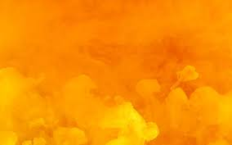
Materials And Methods
For Cyclone Seperator:

Slide 7
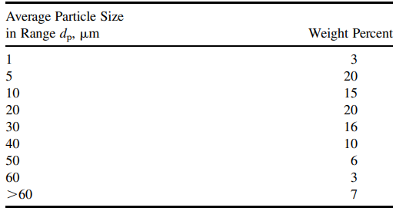
Particle Size Distribution Data

Slide 8
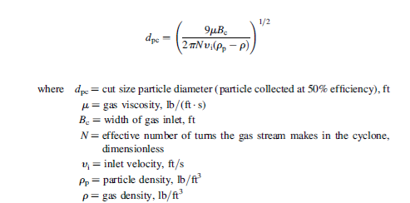
Formula
1. Cut size particle Diameter

Slide 9

2. Efficiency :
Where, dp = Diameter of particle

Slide 10

For Electrostatic Precipitator
Finding Efficiency while varying the particle size:
Assuming,the cut diameter for a precipitator with a 10 inch plate spacing is 0.9 mm, this particular model will perform with an efficiency of 98% under your operating conditions,the effluent loading does not exceed 0.2 gr/ft^3 ; the inlet loading is 14 gr/ft^3

Slide 11
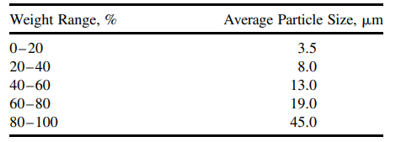
Particle size distribution table

Slide 12
Formula and solution

Slide 13


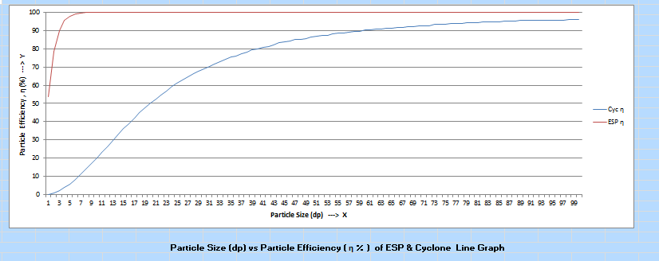
Result and Discussion

Slide 14
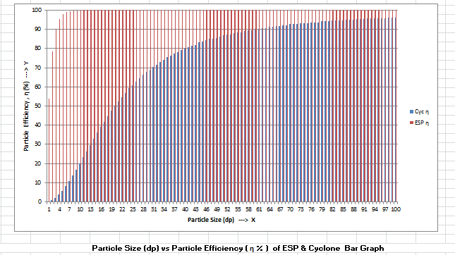

Slide 15
The result we noted that Electrostatic precipitator(ESP) is better than Cyclone Seperator for small fine particles ranging from 1-100 micro meter.

Slide 16

Summary and Conclusion
We have researched the Air Pollution Control tool that are used in industries for particle seperator which removes the fine harmful particles and makes it in a clean air
From, the result we noted that Electrostatic precipitator(ESP) is better than Cyclone Seperator for small fine particles ranging from 1-100 micro meter.
We conclude that Electrostatic precipitator(ESP) is better for small fine particles ranging from 1- 100 micro meter and Cyclone Seperator is used for large particle sizes.

Slide 17

Acknowledgements
We are really grateful because we managed to complete our assignment within the time given by our professor Dr. Siddappa S. Bhusnoor with the help of our group member,Sangeet Pandit(1614032) and Aayush Vora(1714063).We also sincerely thank our professor Dr. Siddappa S. Bhusnoor for guidance and encouragement in finishing the assignment and providing with knowledge of this course.

Slide 18

References
Lapple, C.E., "Processes use many collection types", Chemical Engineering, 58, 145 (1951).
Leith, D., and W. Licht, "The collection efficiency of cyclone type particle collectors—a new theoretical approach", AIChE Symposium Series, Vol. 68, No. 126 (1973).
Shepard, C.B., and C.E. Lapple, "Flow pattern and pressure drop in cyclone dust collectors", Industrial and Engineering Chemistry, 31, 972 (1939).
Louis Theodore,” AIR POLLUTION CONTROL EQUIPMENT CALCULATIONS”, John Wiley & Sons, Inc (2008).
M.Bohnet,”Cylone Seperator for fine Particles And Difficult Operating Conditions”,1994.
L. GUAN , G. HARVEL, S. PARK, J.S. CHANG,” Dust Flow Separator Type Electrostatic Precipitator for a Particulate Matter Emission Control from Natural Gas Combution”, 11th International Conference on Electrostatic Precipitation.
NPTEL – Chemical Engineering – Chemical Engineering Design – II,” https://nptel.ac.in/content/storage2/courses/103103027/pdf/mod5.pdf ”.
B. Sagot, A. Forthomme, L. Ait Ali Yahia, G. De La Bourdonnaye,” Experimental study of cyclone performance for blow-by gas cleaning applications”, May 2017 Journal of Aerosol Science 110.
ESP Design Parameters and Their Effects on Collection Efficiency,” https://ppcair.com/pdf/EPA%20Lesson%20Lesson%203%20-%20ESP%20Parameters%20and%20Efficiency.pdf ”.
Anderson, E. 1924. Report, Western Precipitator Co., Los Angeles, CA. 1919. Transactions of the American Institute of Chemical Engineers. 16:69.

Slide 19
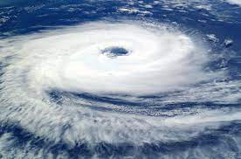
Thank You

